Slide 1
Operating Systems
Manager of Everything!!!

Slide 2
Presenter
Moniruzzaman
Registration ID: 11724150122

Slide 3
Definition

Slide 4
What is OS?
An Operating system (OS) is system software that manages computer hardware, Software resources, and provides common services for computer programs.

Slide 5
Example of OS
Microsoft Windows · 2. Mac OS · 3. Android OS · 4. Linux · 5. Ubuntu · 6. Chrome OS · 7. Fedora.

Slide 6
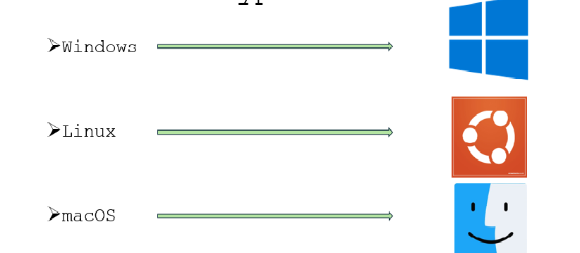
Different Types of OS

Slide 7
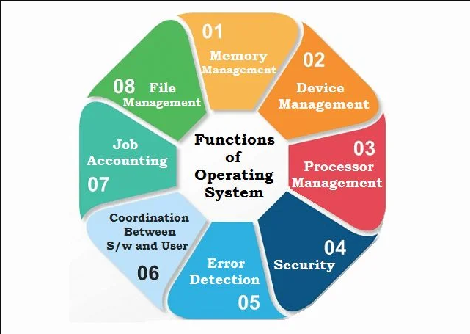
Functions of an OS
Process Management
Memory Management
File system Management
Device Management
Security and Access Control

Slide 8


Installation video
Windows
Linux

Slide 9
Comparison
Windows
Linux
Graphical User Interface (GUI) that is consistent and user friendly across versions.
Standardized desktop environment with limited customization option.
Proprietary software, requires the purchase of license.
Wide range of commercial software available
Multiple desktop environments available
Highly Customizable Interfaces, allowing users to alter the look and feel extensively.
Free and open-sources
Extensive repositories of free and open-sources software.

Slide 10


